Slide 1




Curriculum Workshop
Parents and Carers
2020
OVERMONNOW PRIMARY SCHOOL
CURRICULUM WORKSHOP
PARENTS AND CARERS
2020

Slide 2


Why and when are we changing the curriculum?
The world is changing rapidly, with astonishing advances in technology, lifestyles and the world of work. These changes have profound implications for what and how children learn.
In 2014, the Welsh Government commissioned this report from the OECD.
Short comings of present curriculum
Poor PISA performance
Concerns over transition points
High degree of prescription in curriculum is affecting creativity
External expectations affecting creativity and responsiveness of pupils
Curriculum devised in 1988, does not cater for advances in technology.
‘Deliver a transformational new curriculum, to embed the four purposes and ensure that all are focused on higher standards of literacy and numeracy and ensuring our young people are more digitally and bilingually competent.’

Slide 3
Why and when are we changing the curriculum? https://www.youtube.com/watch?v=0jEaastz224&t=23s
Work on developing the new curriculum is well underway, but this is not a process that will be rushed. The key milestones on the journey are set out below.
2015 - 2016: Pioneer Network established
2015 - 2019: Design and development phase of the new curriculum
September 2016: Digital Competence Framework available
2017 - 2022: Practical support to schools to prepare for the new curriculum
April 2018: Initial National Approach to Professional Learning Available (Phase 1)
April 2019: National Approach to Professional Learning Available (Phase 2)
April 2019: New curriculum and assessment arrangements available for feedback
January 2020: Final curriculum and assessment arrangements available
April 2020: Full Implementation of National Approach to Professional Learning (Phase 3)
September 2022: All maintained schools and settings using the new curriculum and assessment arrangements
The first teaching of all year groups from primary school to Year 7 will begin in September 2022 and the new curriculum will roll out year-on-year from this point.

Slide 4
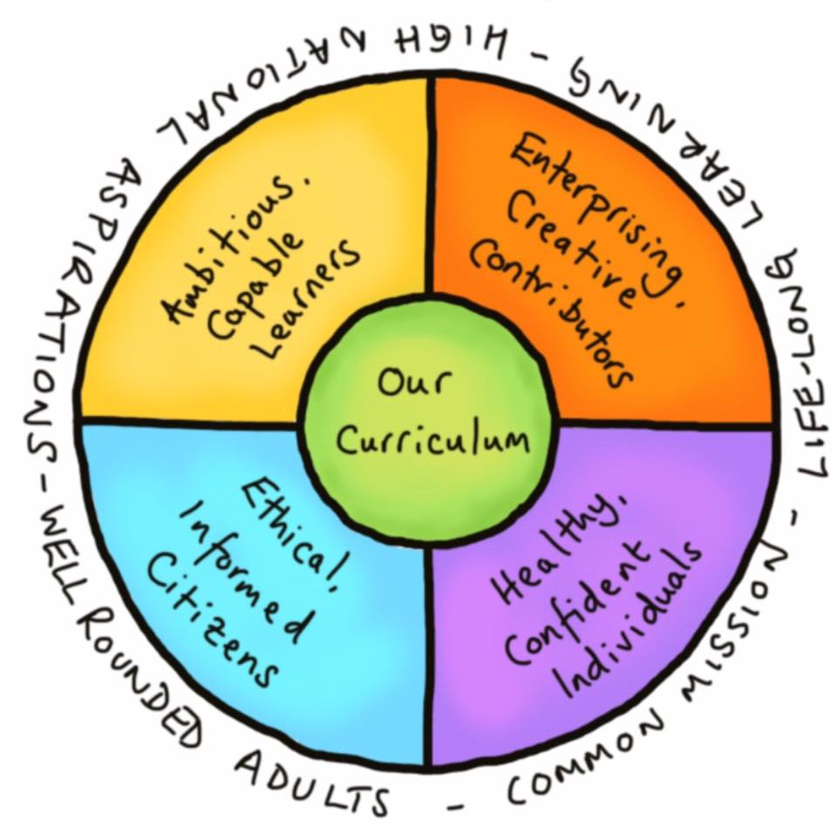
What is changing?
https://www.youtube.com/watch?v=9U0fsT0gH7U
Four purposes of education
Six areas of learning/experience
Three cross-curriculum responsibilities
Progression Steps at ages 5, 8, 11, 14 and 16.
A range of pedagogical approaches
Refocus on Assessment for learning

Slide 5


Slide 6

Our Curriculum
A purpose led curriculum – with the four purposes at the heart (life skills, health and wellbeing).
Include authentic learning experiences (relevant and engaging).
Organised as a continuum of learning from 3 to 16 – children working by stage not age.
Organised around ‘What Matters’ statements for each AoLE.
Organised around descriptors of learning (at 5, 8, 11, 14 and 16).
Cross curricular and not biased towards some subjects (inclusive of all learners).
Curriculum for Wales 2022 consists of:
A national level framework.
School level design and planning.

Slide 7
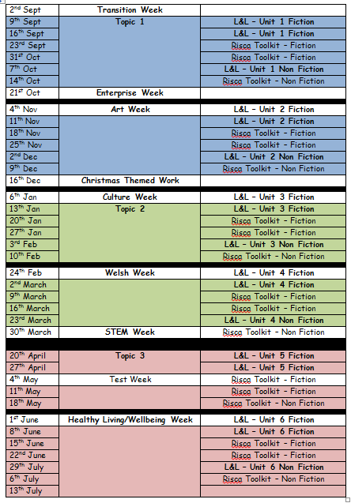
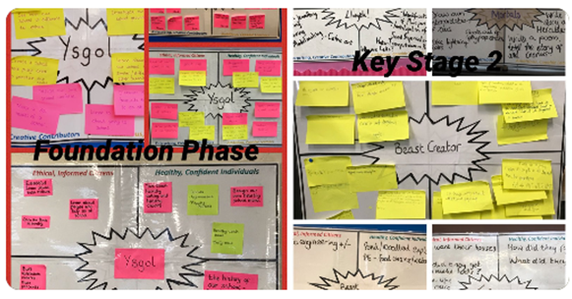
Our Curriculum – Where are we?
Through out the year we deliver three topics based on the ideas of the learners.
These are interspersed with Authentic learning weeks providing the children with further projects that are presented in real life contexts.

Slide 8
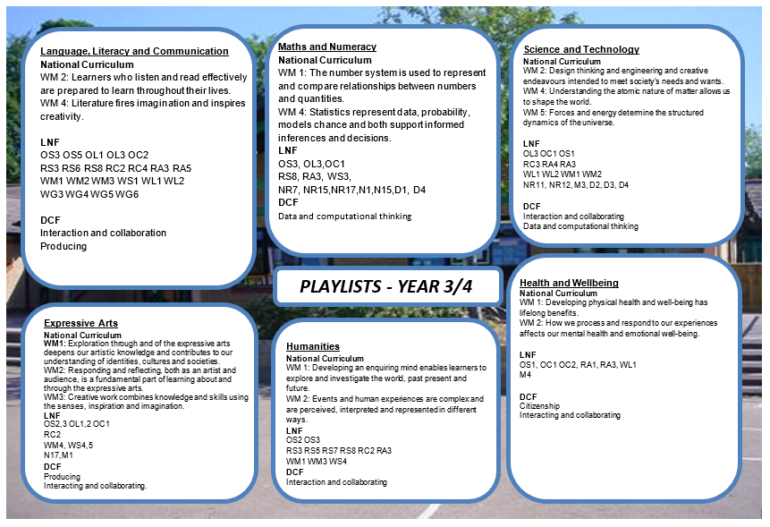
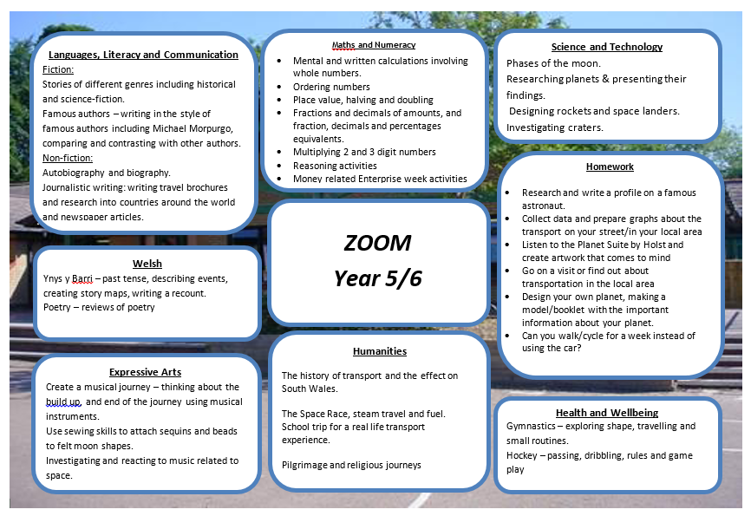
Teachers take the ideas of the learners and turn them into engaging learning experiences.
Map these learning experiences against the new curriculum framework to ensure the children have range of coverage.

Slide 9

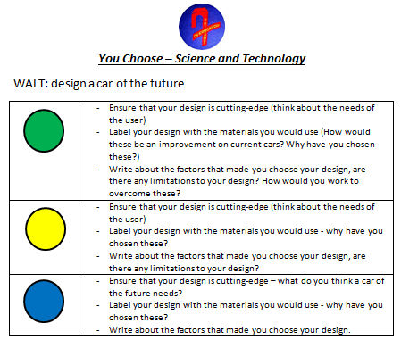
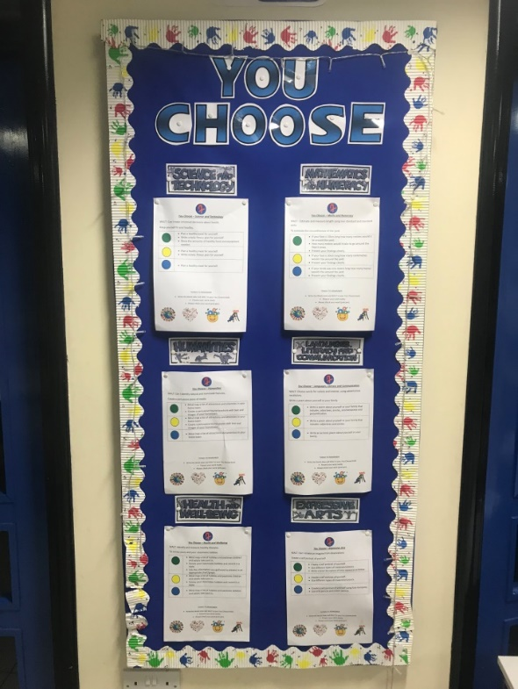
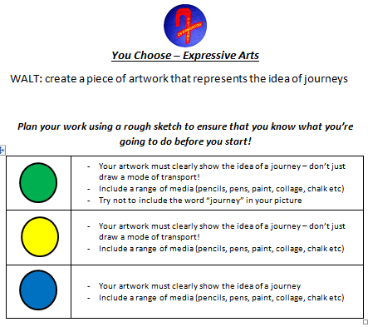
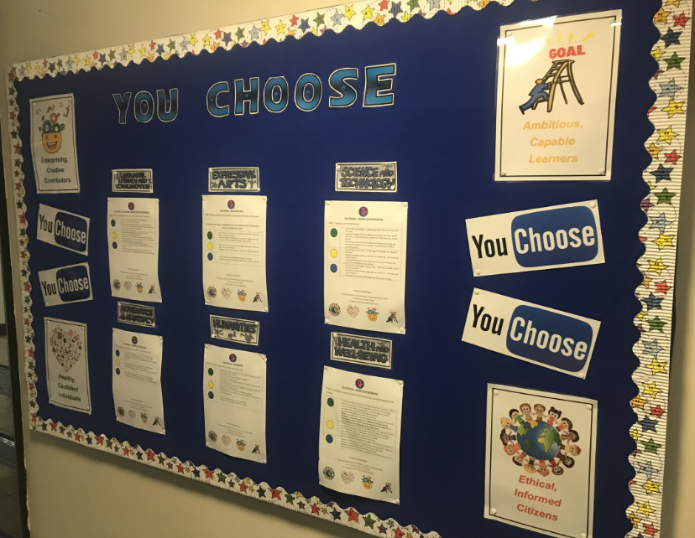
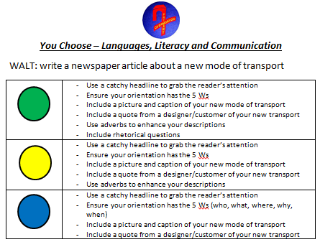
To develop understanding of the new curriculum eg. 6 AoLE.
To develop the learners opportunities to make their own learning choices/experiences.
To build upon learners previous knowledge, applying their skills in an approach that suits them.
I really like the concept of choosing what you can do
It’s kind of self-explanatory “You Choose” the thing you want to do.
I enjoy You Choose because you get to pick what activities you want to do and you get to work with different people

